Slide 1
Paris metro and optimal business location

Slide 2
Description of the initial problem
1 / For this week, you will required to submit the following:
A description of the problem and a discussion of the background. (15 marks) A description of the data and how it will be used to solve the problem. (15 marks)
2 / For the second week, the final deliverables of the project will be:
A link to your Notebook on your Github repository, showing your code. (15 marks) A full report consisting of all of the following components (15 marks):
Introduction where you discuss the business problem and who would be interested in this project.
Data where your describe the data that will be used to solve the problem and the source of the data.
Methodology section which represents the main component of the report where you discuss and describe any exploratory data analysis that you did, any inferential statistical testing that you performed, if any, and what machine learnings were used and why.
Results section where you discuss the results.
Discussion section where you discuss any observations you noted and any recommendations you can make based on the results.
Conclusion section where you conclude the report.
3 / Your choice of a presentation or blogpost. (10 marks)

Slide 3
Business problem
Paris and its suburbs are managed by a company called RATP for transports. We will analyse the stations from the RATP open data website and try to understand how it works trough geolocalisation data. The goal is to find geolocalised points that may suit the opening of a business based on public transport availability.
1/ We will get the food data from foursquare API and see how many food venues there is for each station as an example and plot it in folium
2/ We will use a clustering algorithm to understand the best positions that are accessible trough public transport ( of RATP ) based on their data

Slide 4
Data
The data is accessible at this link
https://data.ratp.fr/explore/dataset/positions-geographiques-des-stations-du-reseau-ratp/information/?disjunctive.stop_name .
It is from RATP which is representing France main region transport system , it is part of the open data, which is free and accessible.
The data by itself has a latitude and longitude + name and adress of the stations.
- Latitude and longitude will be used to get specific locations and plot it on a map with folium
- Latitude and longitude will be used to get information from foursquare API.
- Latitude and longitude will be used by the algorithm to find best positions
In all cases the data needs to be transformed to be used in terms of analysis. The data set will anyway be reduced and filtered to avoid duplicates, it may be simplified as well to be able to fit the number of maximum calls per day we have with the foursquare API.

Slide 5
Methodology
Many data transformation have been done to be able to use folium and make a map + use the k-mean algorithm in the next steps
Simple steps :
Data transformation
Exploration
Algorithm

Slide 6
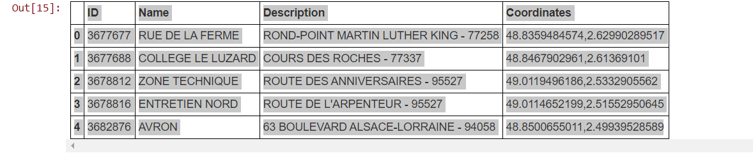
Data format

Slide 7
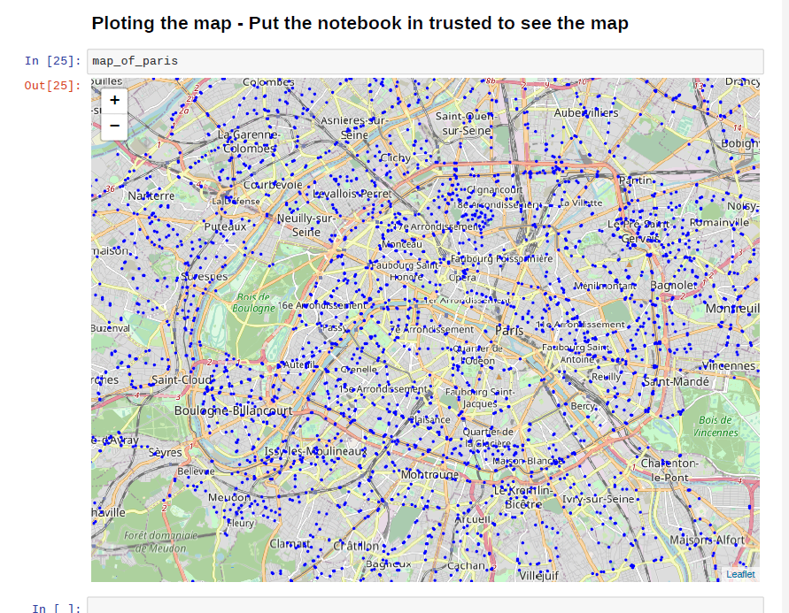
Showing station locations

Slide 8
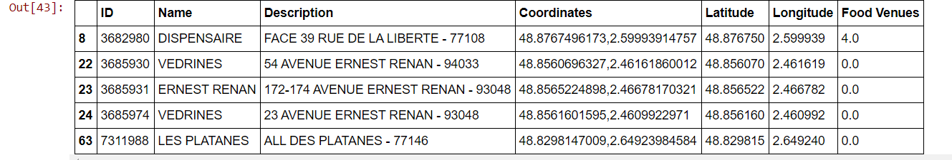
Using foursquare to get number of venues

Slide 9
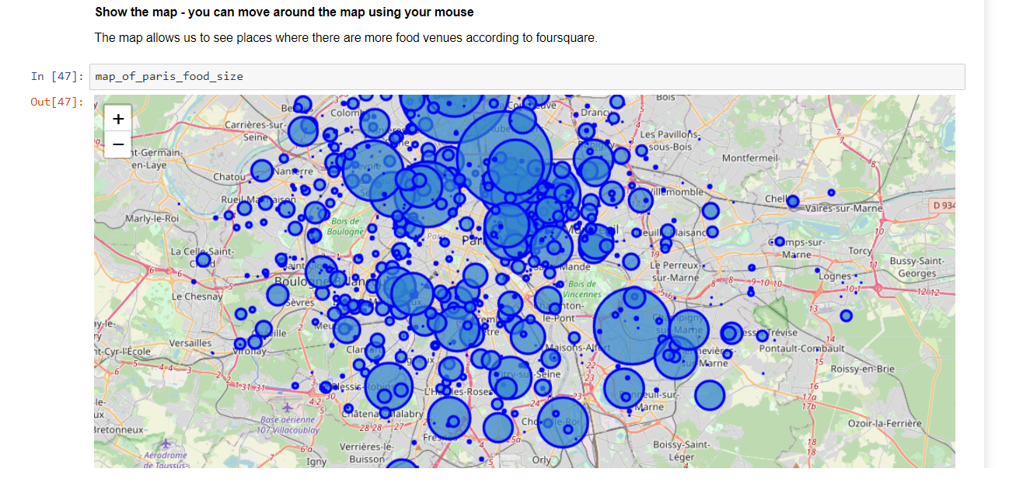
Plotting the number of food venues by station location

Slide 10
Algorithm
We will be using k-mean to cluster different points and get the best centroids for our business location

Slide 11
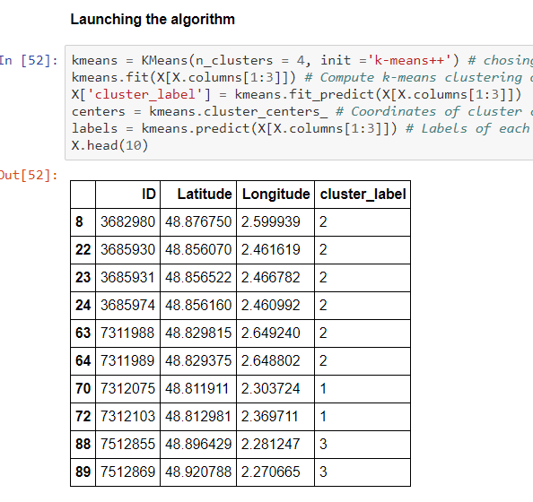
K-mean result

Slide 12
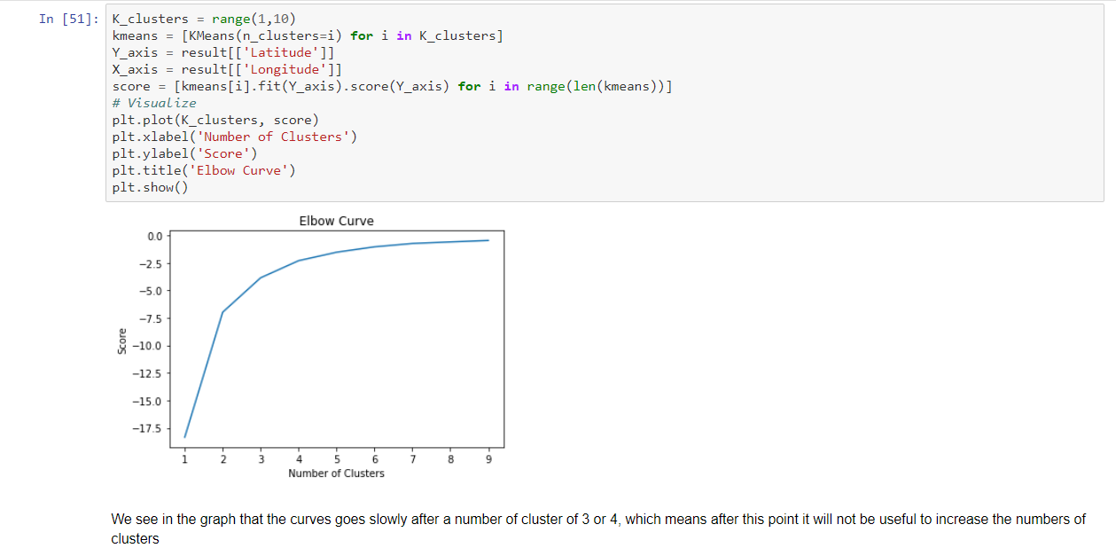
Optimal k-mean cluster number

Slide 13
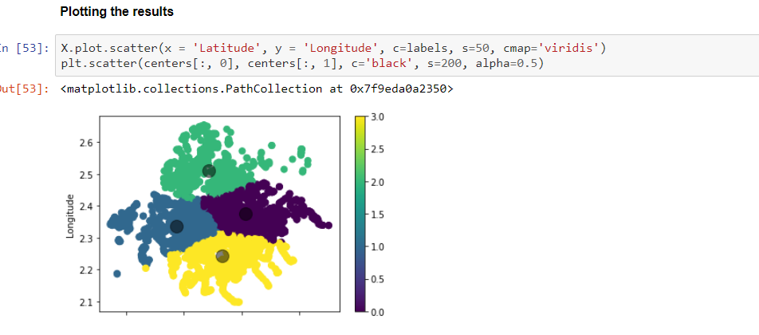
Plotting clusters

Slide 14
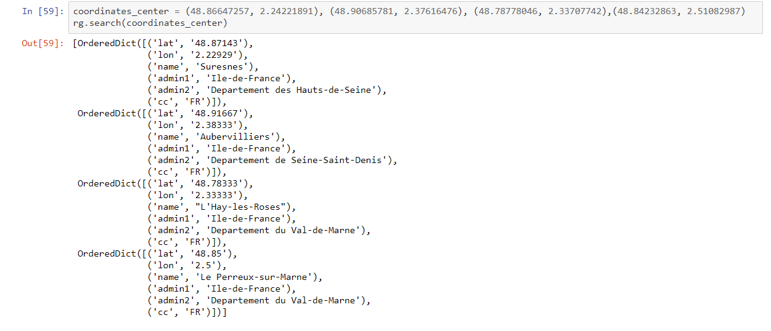
Best locations for business opening / public transport availability

Slide 15
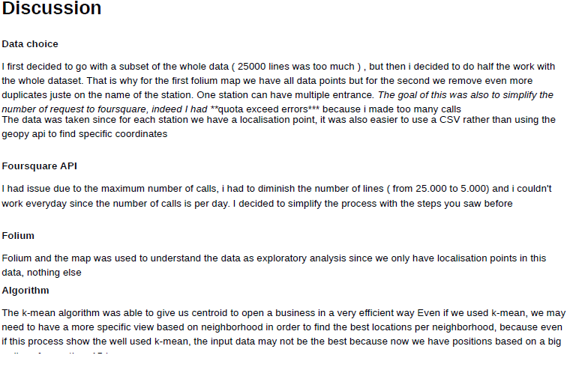

Slide 16
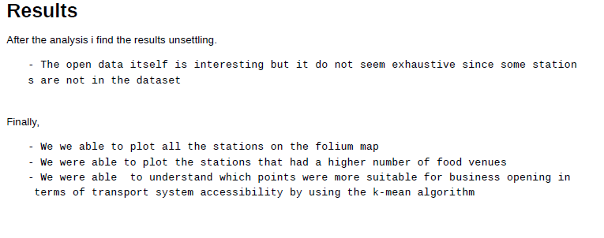

Slide 17
